Slide 1


Part.3 Global Sale VS. Critical Score Global Sale VS. User Score
Question
Did critical and user reviews correlate with the total sales of the game globally?

Slide 2
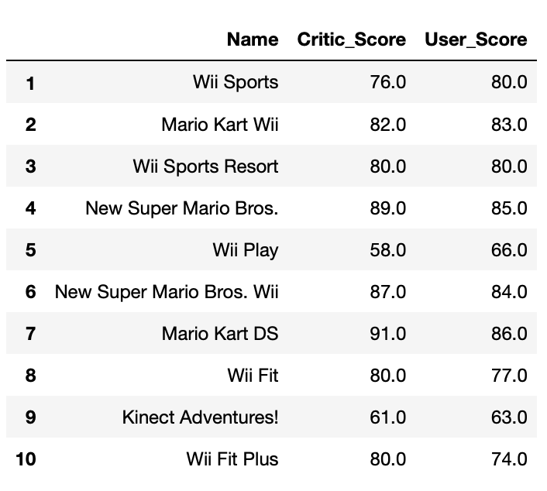
Sales, Critics, And User Score Of The Top10 Games
Top 10 Best Selling Games (Globally)

Slide 3
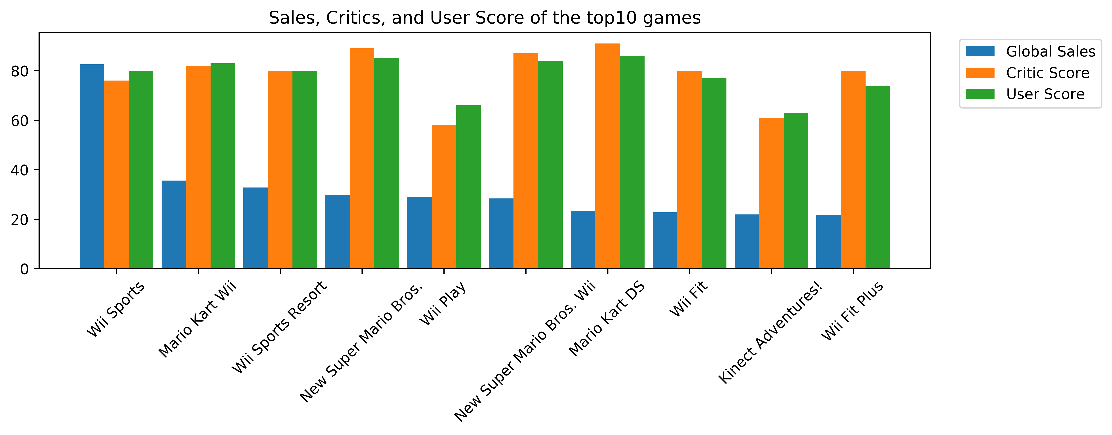

Sales, Critics, And User Score Of The Top10 Games
Results: No obvious data shows that the highest-selling games have the highest user ratings.

Slide 4
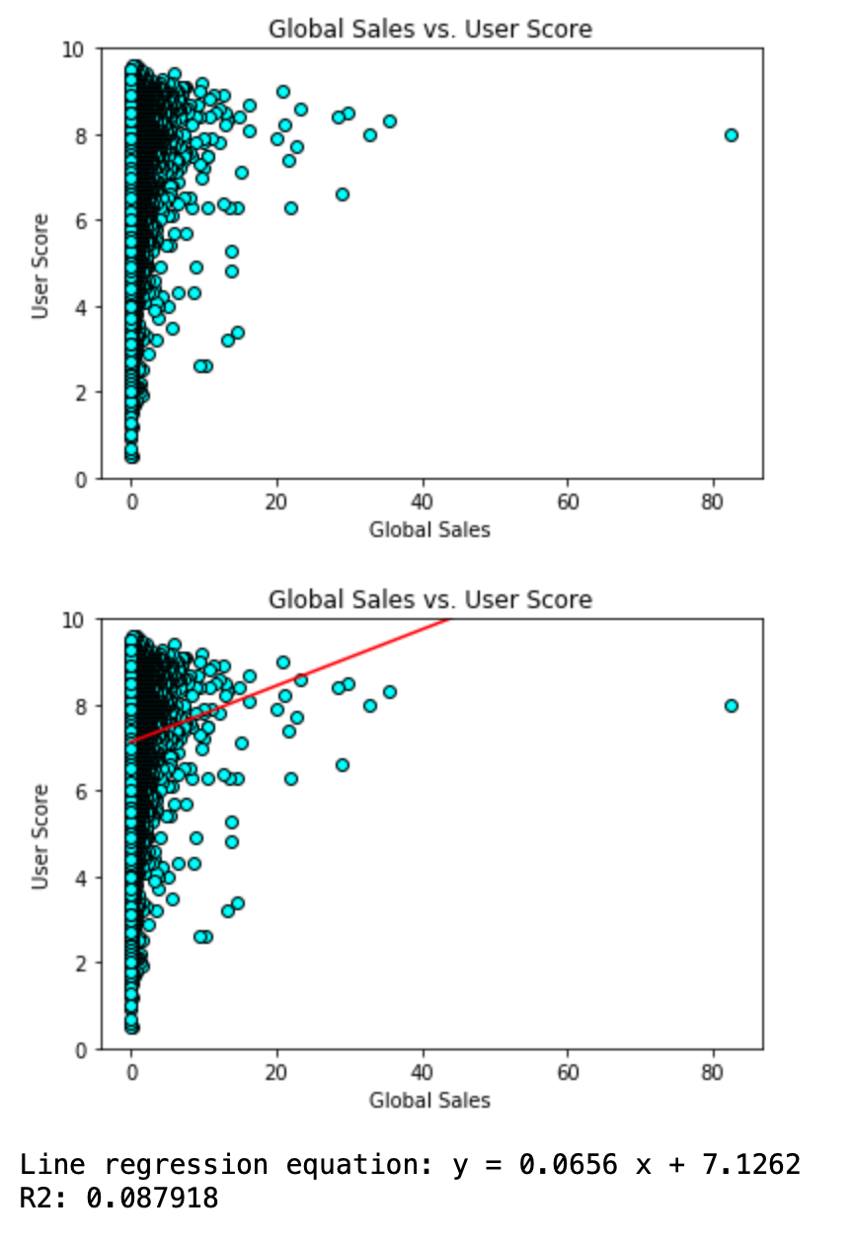

Global Sale Vs. User Score
Results:
Games with sales ranging from 0 to 10 (Unit: million pieces) have the widest rating range, with high and low user scores.
Games with sales ranging from 20 to 40 (Unit: million pieces), They all got a user score higher than 6.
The trend shows that it is not the highest-selling game has the highest user score.

Slide 5
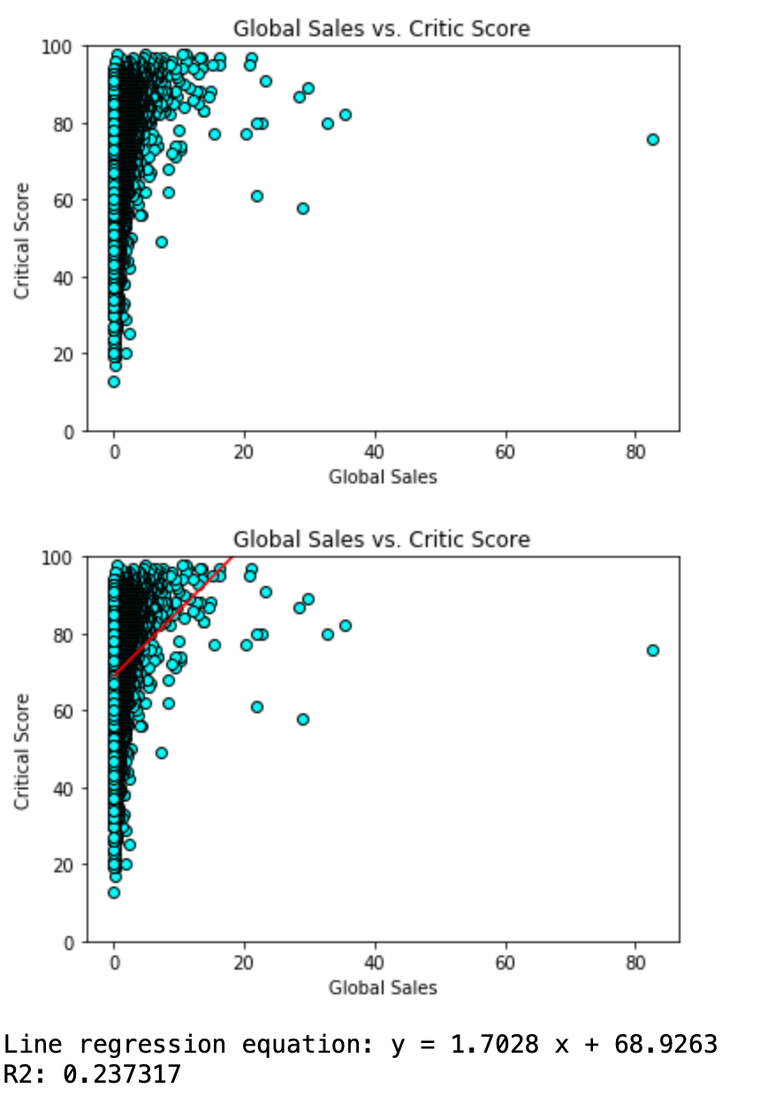
Global Sale Vs. Critical Score
Games with sales ranging from 0 to 10 (Unit: million pieces) have the widest rating range, with high and low critical scores.
Games with sales ranging from 20 to 40 (Unit: million pieces), They all got a critical score higher than 6.
The trend shows that it is not the highest-selling game has the highest critical score.

Slide 6
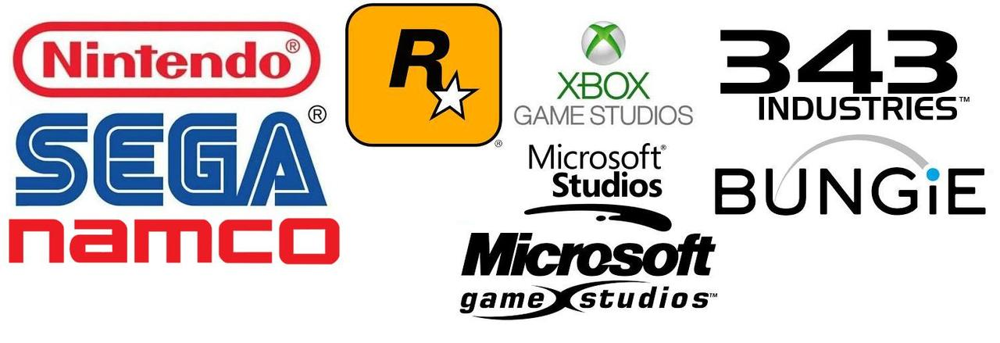
Box Plot: Group To Compare Relevance
Divide The Data Into Three Groups:
Top Sale Game : Global Sale > 10 Million Pieces
Fair Sale Game: Global Sale In Range 1 To10 Million Pieces
Poor Sale Game: Global Sale < 1 Million Pieces

Slide 7
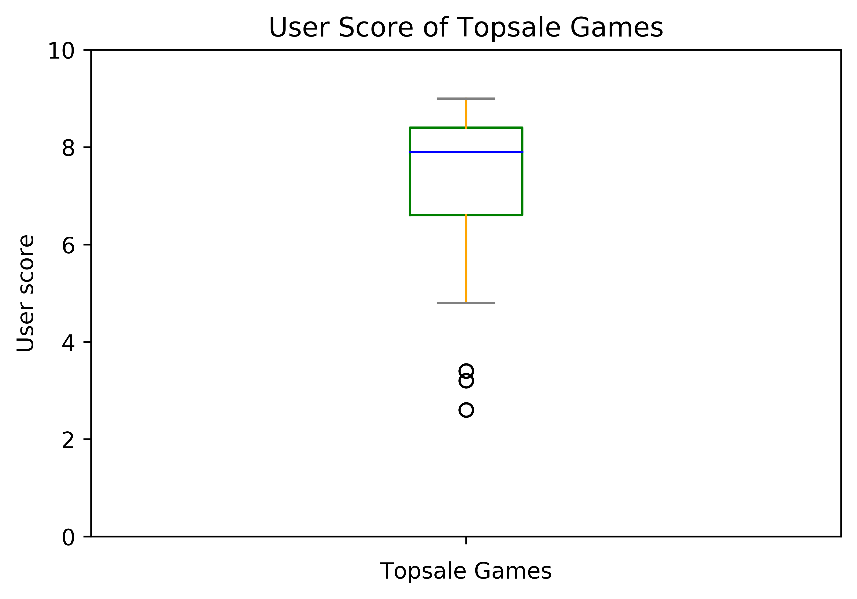
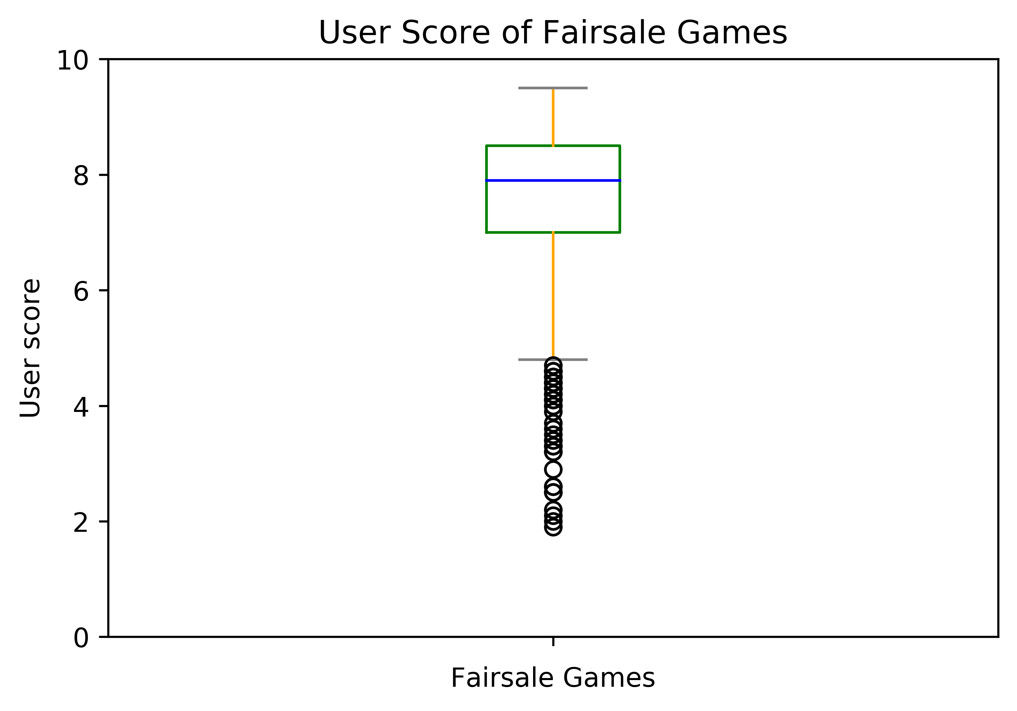
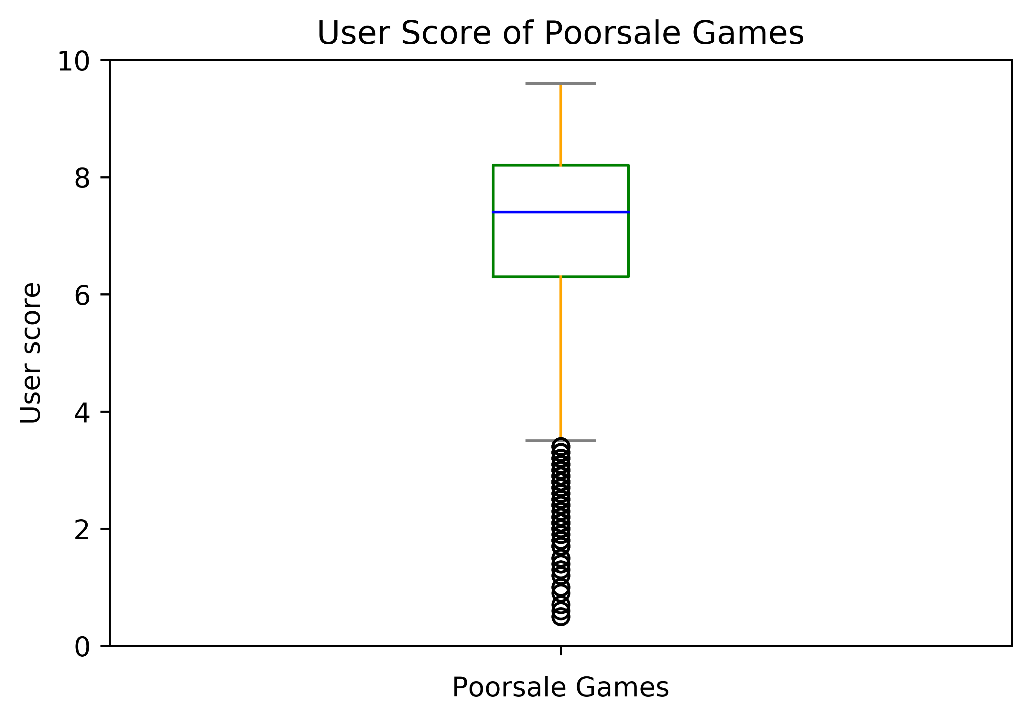
User Score Vs. Game Selling
The top sale game group has only few outliers, which means most of the top sale games have got high user scores, only few of them got user scores below average.
User scores of the top sale game group and the fair sale group are higher than the poor sale game group.

Slide 8
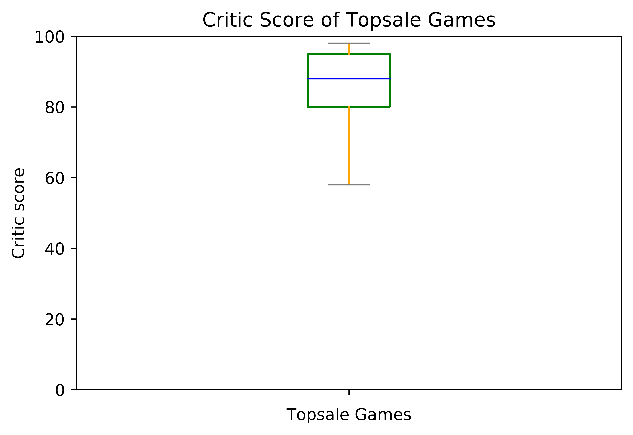
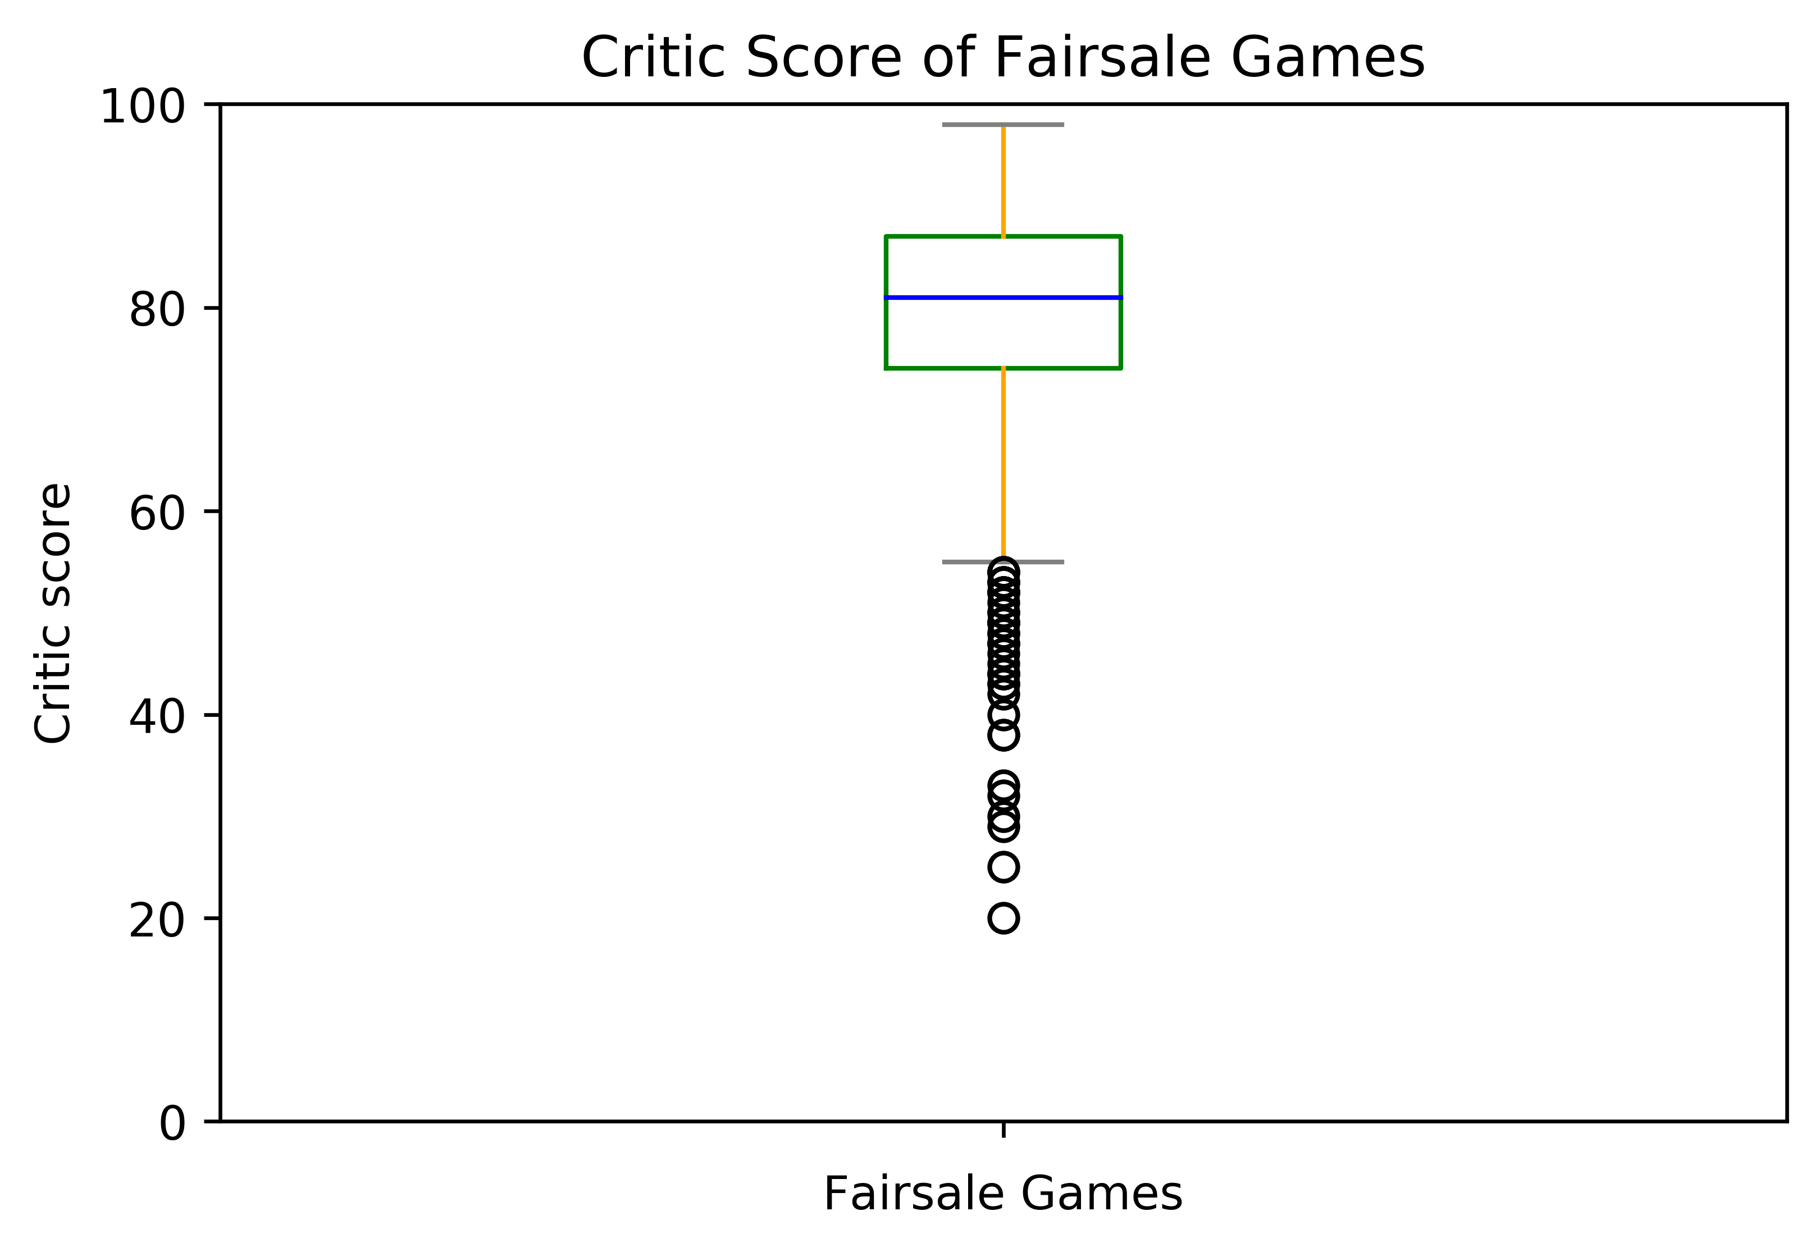
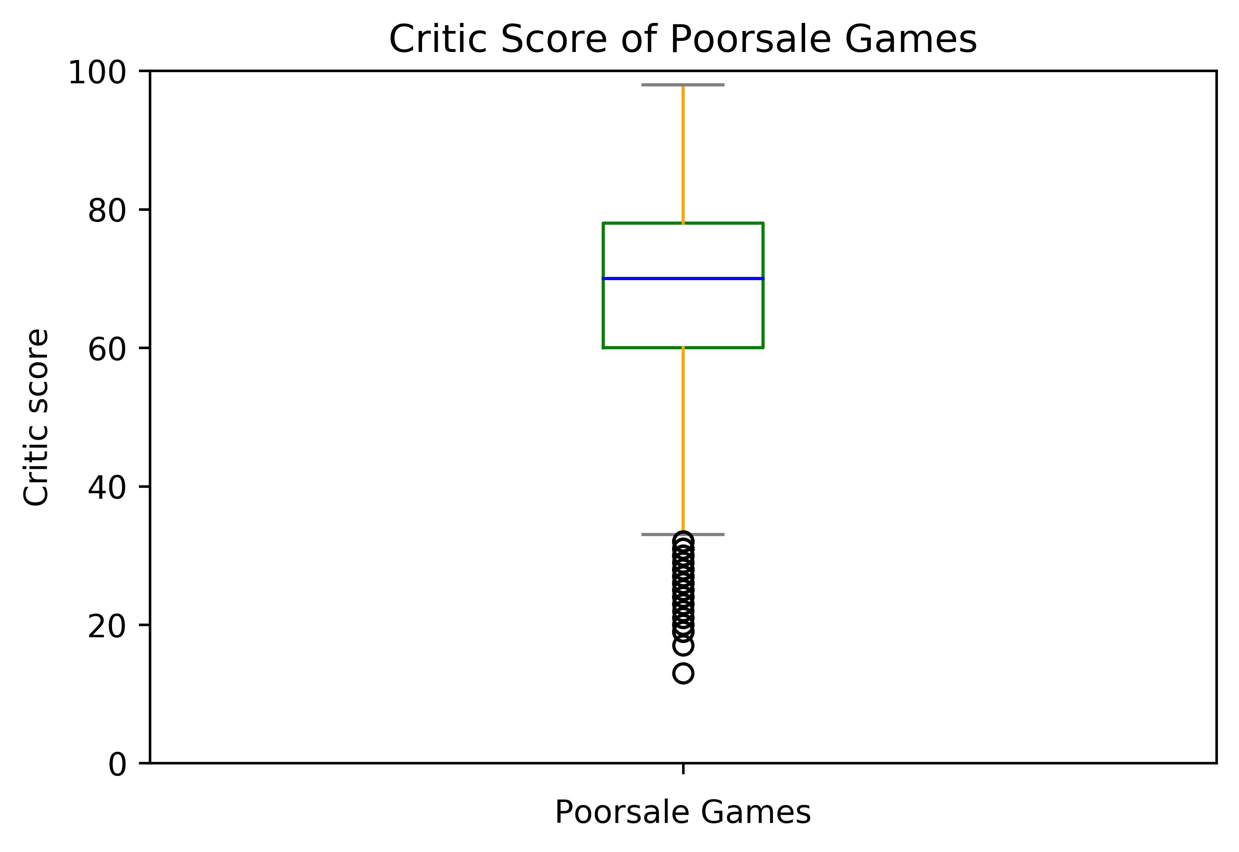
Critical Score Vs. Game Selling
The median of top sale games group is higher than the other two groups .
The top sale game group shows no outliers, which means both of the top sale games have got high critical scores.
Fair sale game group have higher critical score than poor sale game group, but a lot of outliers exist.

Slide 9
Conclusion
Quantities of each video games’ global selling and their user scores are positively related.
There is a strong correlation between global sale and critical reviews.
Global video game selling is proportional to the games’ critical reviews.
Top selling games have higher user scores and critical scores on average than lower selling games .
The highest-selling game has not got the highest critical score.
Although some games are not sold well, they have high user/critical score ratings.

Slide 10

Limitation
Not enough game players participate in scoring and rating.
Lack of detailed information about rating players, for example, players’ age ,gender ,and occupation etc.
Existence of missing data.

